Slide 1
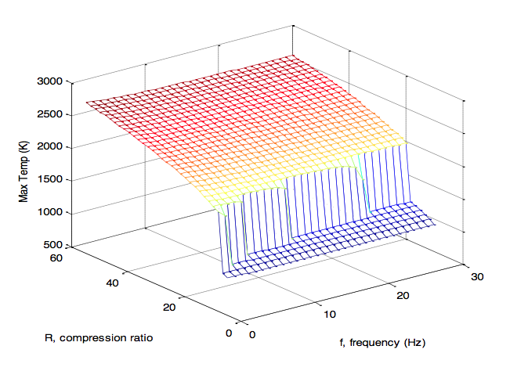
Parallel Computing using Amazon Cloud and GNU Octave Parallel Package
Often to analyze mechanisms or reactors you will want to run the same simulation with 1000s of different parameter combinations, to analyze engine behavior or other tasks.
Amazon Cloud
Local Computer:
-Load data.mat and plot graphs
Master Computer:
-Sends out commands to slaves
-Saves results to data.mat
Slave
Slave
Slave
Slave
Slaves run HCCI reactor and send back key parameters:
Maximum Temperature
Has Ignition Occurred?

